Slide 1
CIS 4930/6930-002 Data Visualization
COLOR
Paul Rosen
Assistant Professor
University of South Florida
slides credits Chris Johnson (U of Utah), Hanspeter Pfister (Harvard), Bang Wong (Broad Institute), Miriah Meyer (U of Utah)

Slide 2
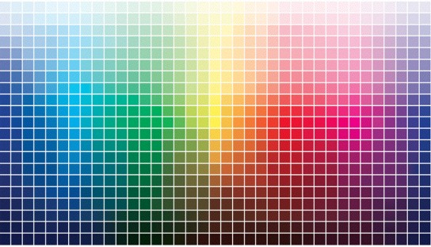
Color

Slide 3
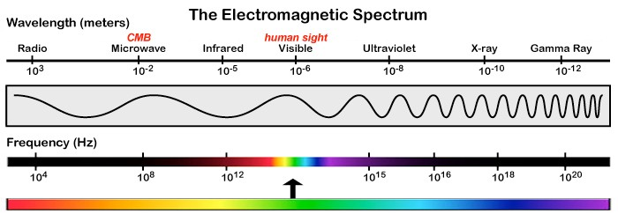
light

Slide 4
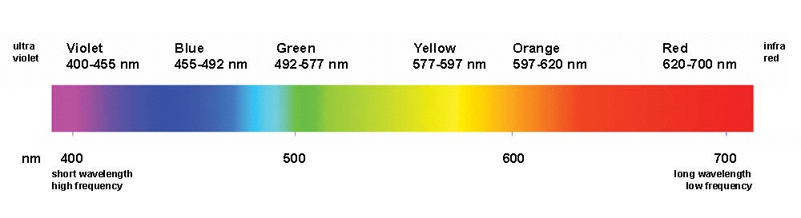
(human) visible light

Slide 5
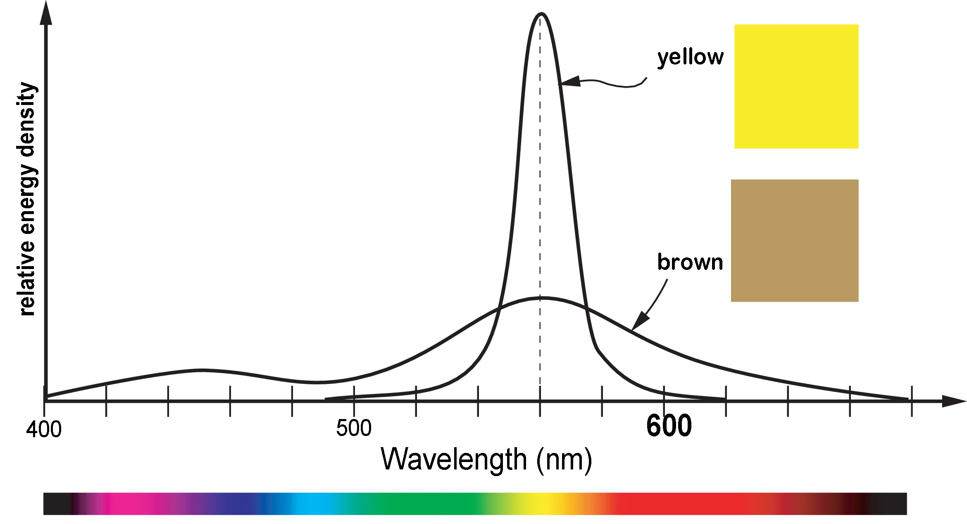
Color != Wavelength
but rather, a combination of wavelengths and energy

Slide 6
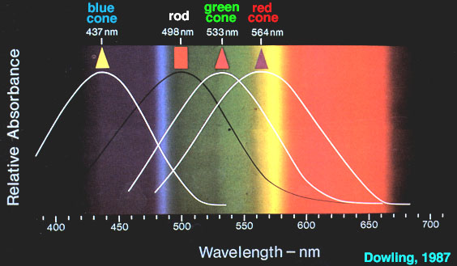
Cone Response

Slide 7
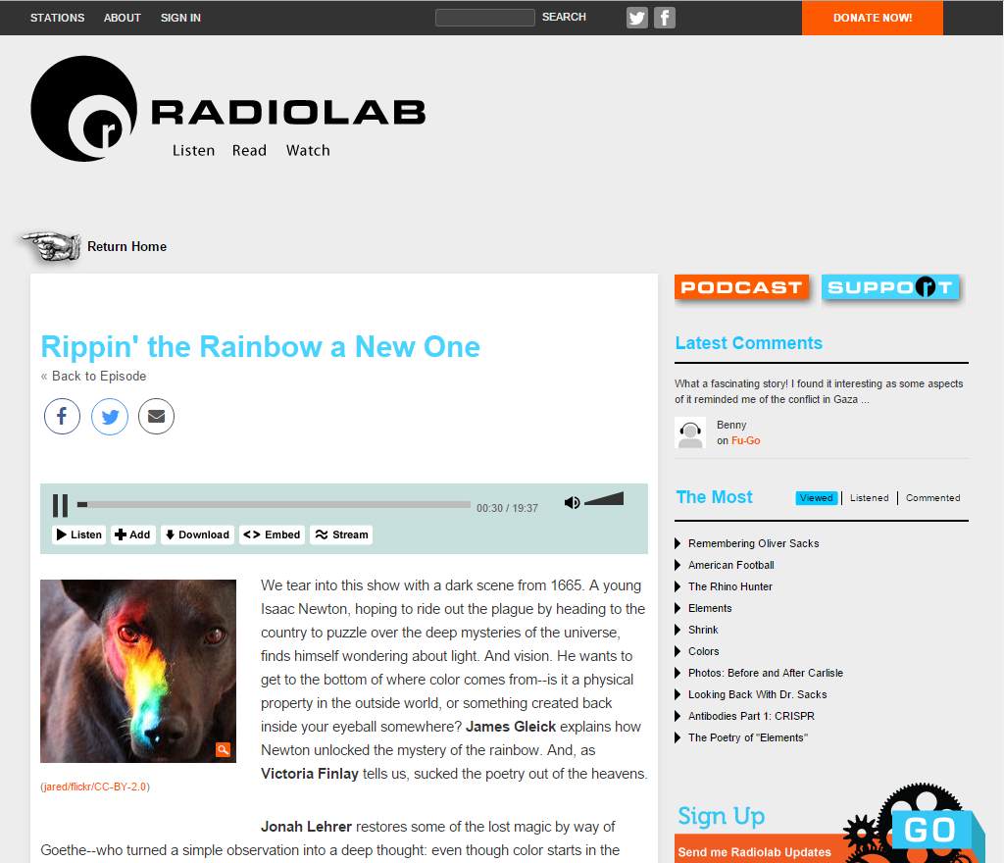

Slide 8
Color abstraction, representation

Slide 9
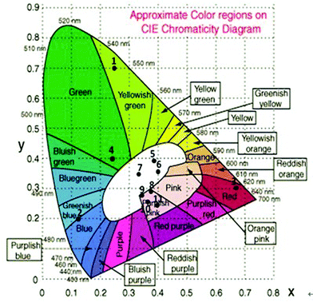
space of human color

Slide 10
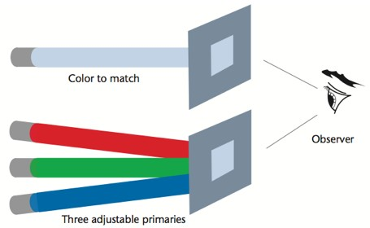
CIE color space
CIE (International Commission on Illumination)
standardized a set of color-matching functions that form the basis for most color measurement instruments
experiments done in the 1920’s and 1930’s
humans can mimic any pure (visible) light by addition and subtraction of three primary lights

Slide 11
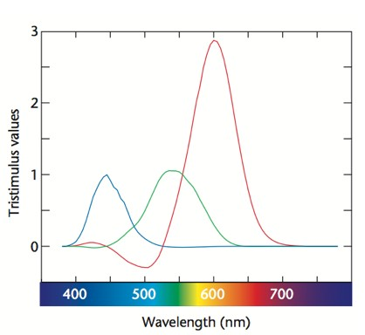
CIE color space
with RGB, addition and subtraction were required to get all visible wavelengths
in nature, light adds (but does not subtract)
any three primaries (additive) can produce only a subset of all visible colors
R: 645 nm, G: 526 nm, B: 444 nm

Slide 12
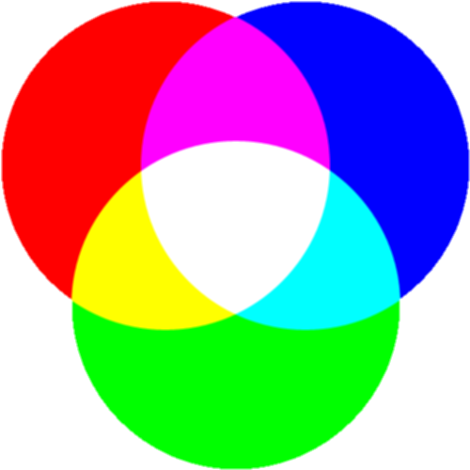
ADDITIVE COLOR
(like we see in light)
primary: RGB
secondary: CMY

Slide 13
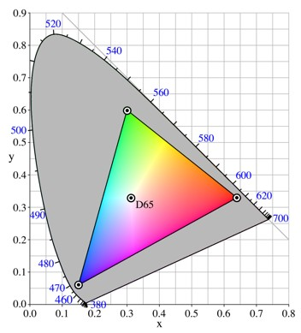
RGB color space
very common color space
not perceptually uniform
actual color is device-dependent
49

Slide 14
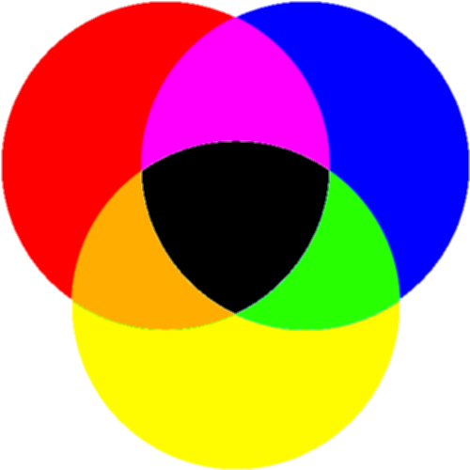
SUBTRACTIVE COLOR
(used in painting)
primary: RYB
secondary: OGV

Slide 15
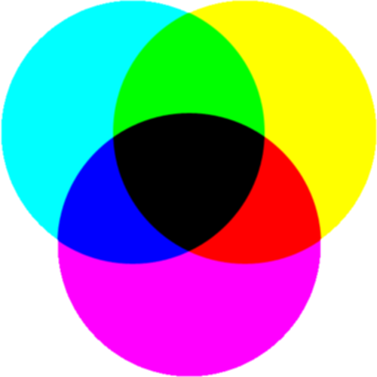
SUBTRACTIVE COLOR
(used in print ink)
primary: CMY
secondary: RGB
approx black = C+M+Y
true black = C+M+Y+K
actual color is device-dependent

Slide 16
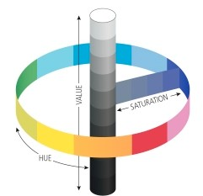
HSV [B, L, I] (additive)
Hue, Saturation, [Value, Brightness, Lightness, Intensity]
polar coordinate representations of RGB space
conical or cylindrical shaped space
more intuitive than RGB for color tuning

Slide 17
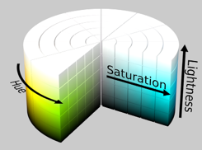
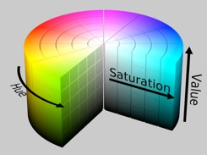
HSV [B, L, I] (additive)
hue: what people think of as color
saturation: amount of white mixed in
luminance: amount of black mixed in
lightness vs value (or brightness)
intensity, in computer vision applications

Slide 18
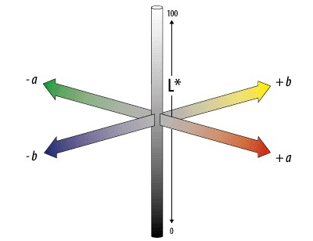
CIE LAB/LUV
mathematically defined & perceptually based to include all perceivable colors
a: red to green
b: yellow to blue
L*: lightness (black to white)

Slide 19
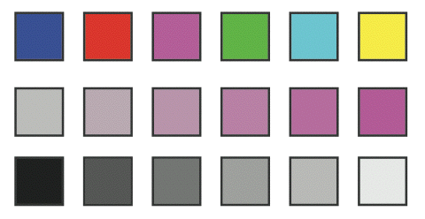
in this class…
hue
saturation
luminance

Slide 20
color deficiencies & limitations

Slide 21
COLOR BLINDNESS
deficiency in color vision
typically caused by faulty cone development
found more in men than women
photopigment genes carried in x-chromosome
5-8% of men and 0.5% of women

Slide 22
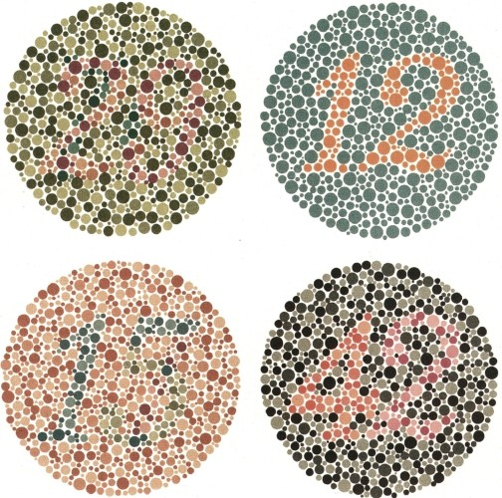

Slide 23
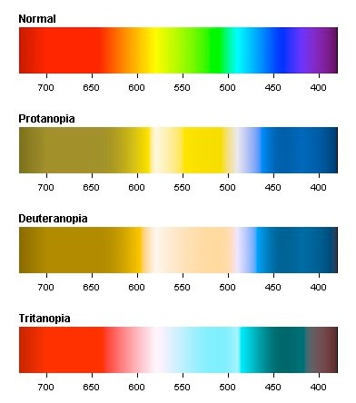
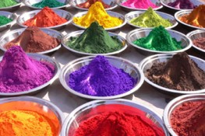
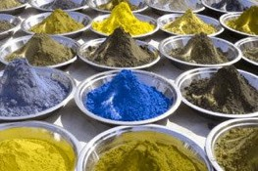
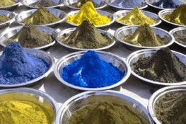
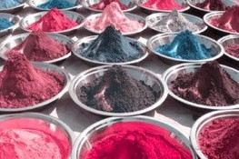

Slide 24
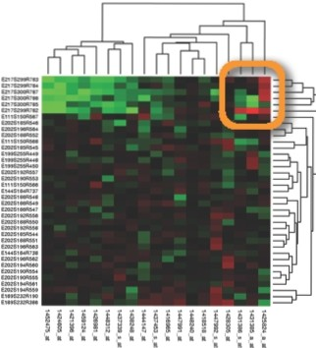
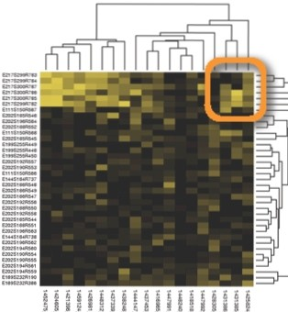
................. .
• •
• •••

Slide 25
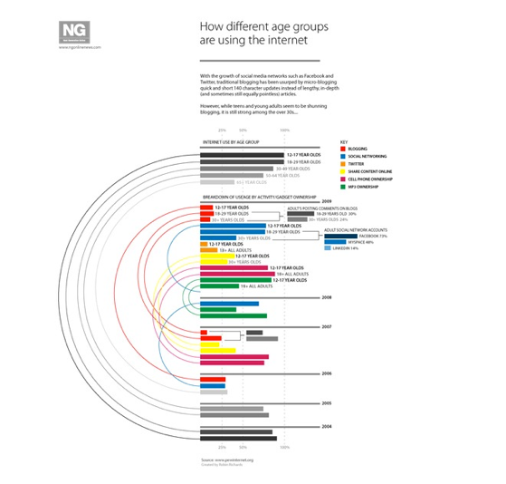
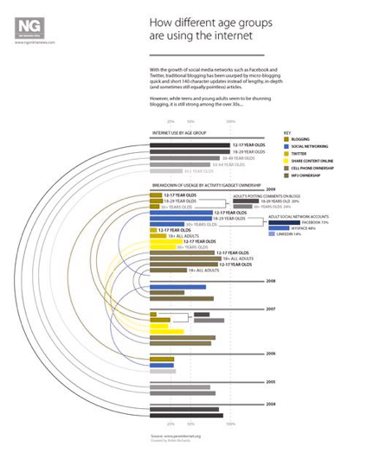

Slide 26
MONOCHROMACY
total color blindness, very rare
1 dimensional color vision
2 or 3 cone pigments are missing
rod monochromacy: non-functioning or missing cones (achromatopsia)
cone monochromacy: multiple deficient cones

Slide 27
DICHROMACY
2 dimensional color vision
1 cone pigment is missing
protanopia: absence of red receptors
deuteranopia: absence of green receptors
tritanopia: absence of blue receptors

Slide 28
TYPES: TRICHOMACY
3 dimensional color vision
1 cone is altered in spectral sensitivity—impairment rather than loss
protanomaly: shift in red, poor red-green discrimination
deuteranomaly: shift in green, poor red-green discrimination (most common form of color deficiency)
tritanomaly: poor blue-yellow discrimination

Slide 29
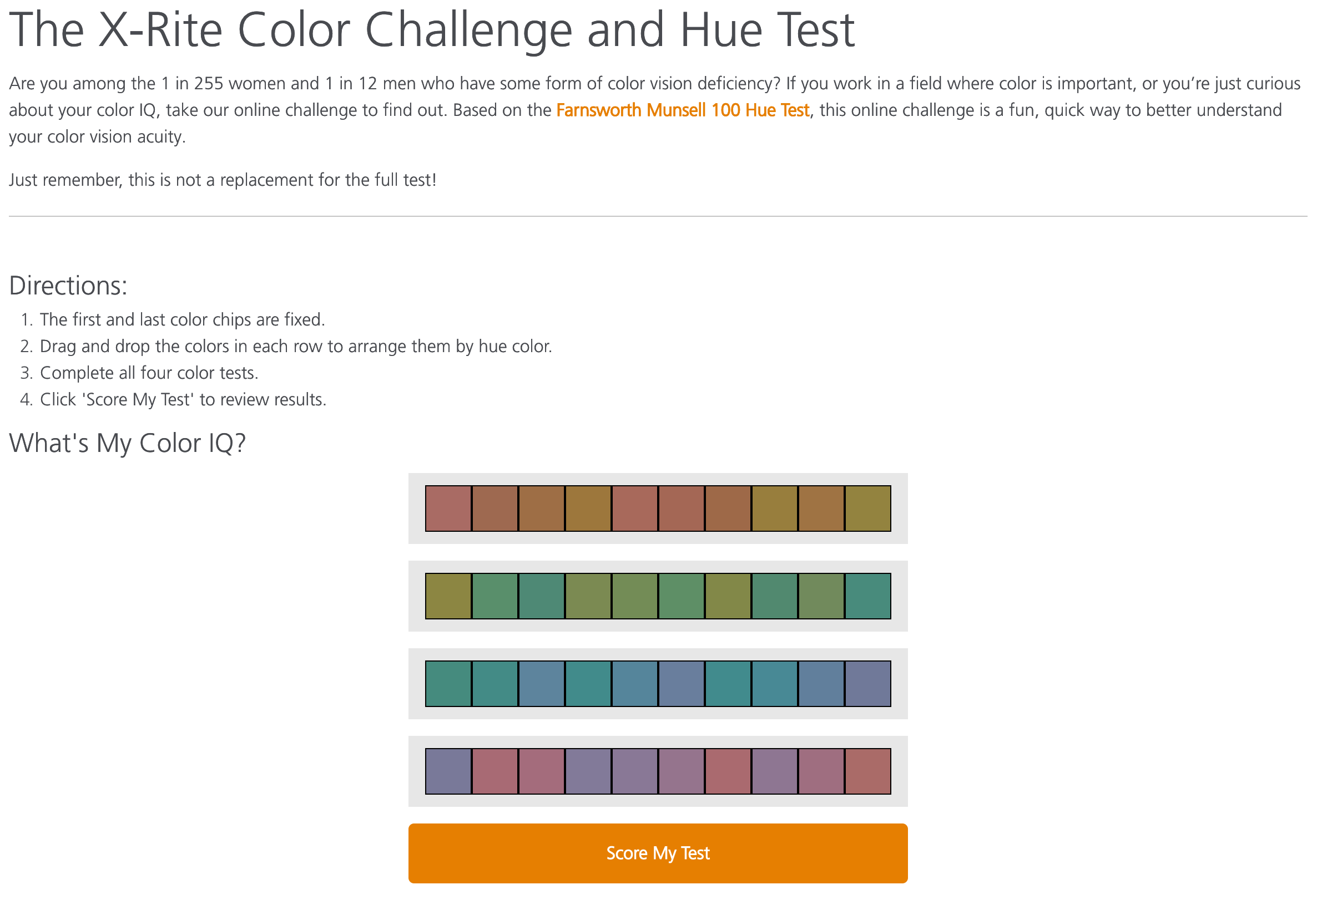

Slide 30
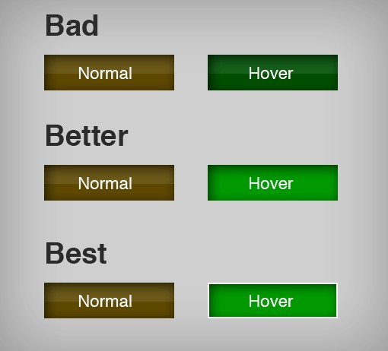
Takeaway
Even if you aren’t colorblind, someone you’re working with could be.
Be sure to design with colorblindness in mind by:
varying hue, saturation, brightness
using monochrome color schemes
using cues besides/in addition to color
software solution, vischeck (http://www.vischeck.com)

Slide 31
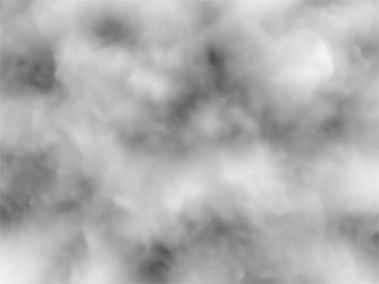
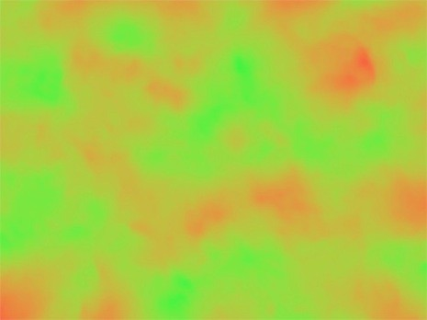
Contrast Sensitivity
C.Ware, “Visual Thinking for Design”

Slide 32
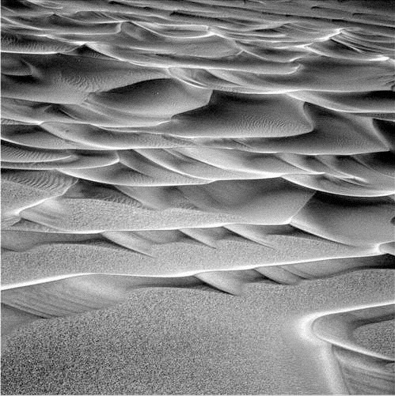
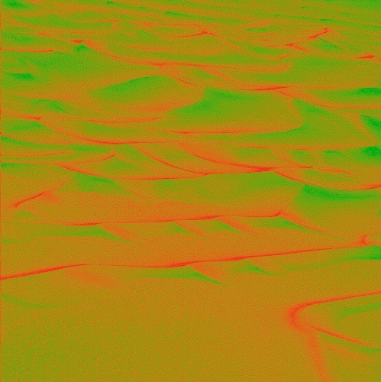
Contrast Sensitivity
C.Ware, “Visual Thinking for Design”

Slide 33
Takeaway
We have higher contrast sensitivity in the luminance than in the chrominance channel. Show preference to luminance for encoding detail.

Slide 34

Color Relativity

Slide 35
Color Relativity

Slide 36
Color Relativity

Slide 37

Color Relativity

Slide 38

Color Relativity

Slide 39


Color Relativity

Slide 40
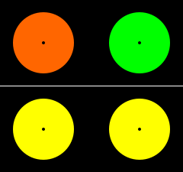



SUCCESSIVE CONTRAST
look at a dot
then look at a dot

Slide 41
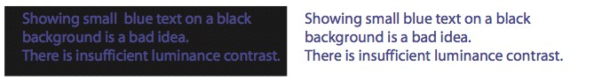
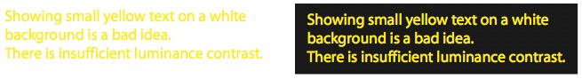
luminance contrast

Slide 42
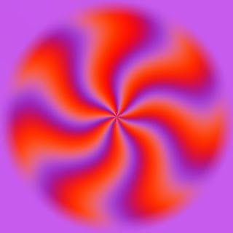
EQUILUMINANT COLORS
strong contrast: shapes seen by color sensitive cells
equiluminance: hides positions from light sensitive cells
flickering/movement caused by this disconnect

Slide 43
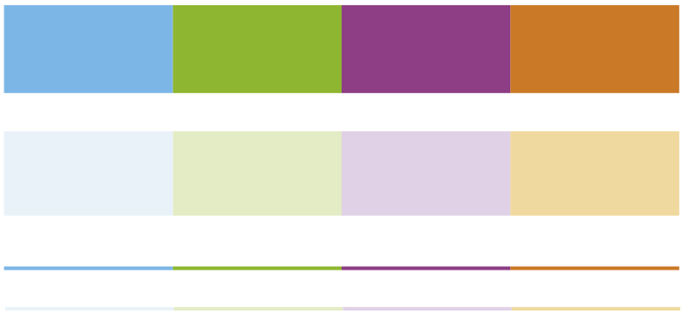
size & color
“the smaller the mark, the less distinguishable are the colors”
-Jacques Bertin

Slide 44
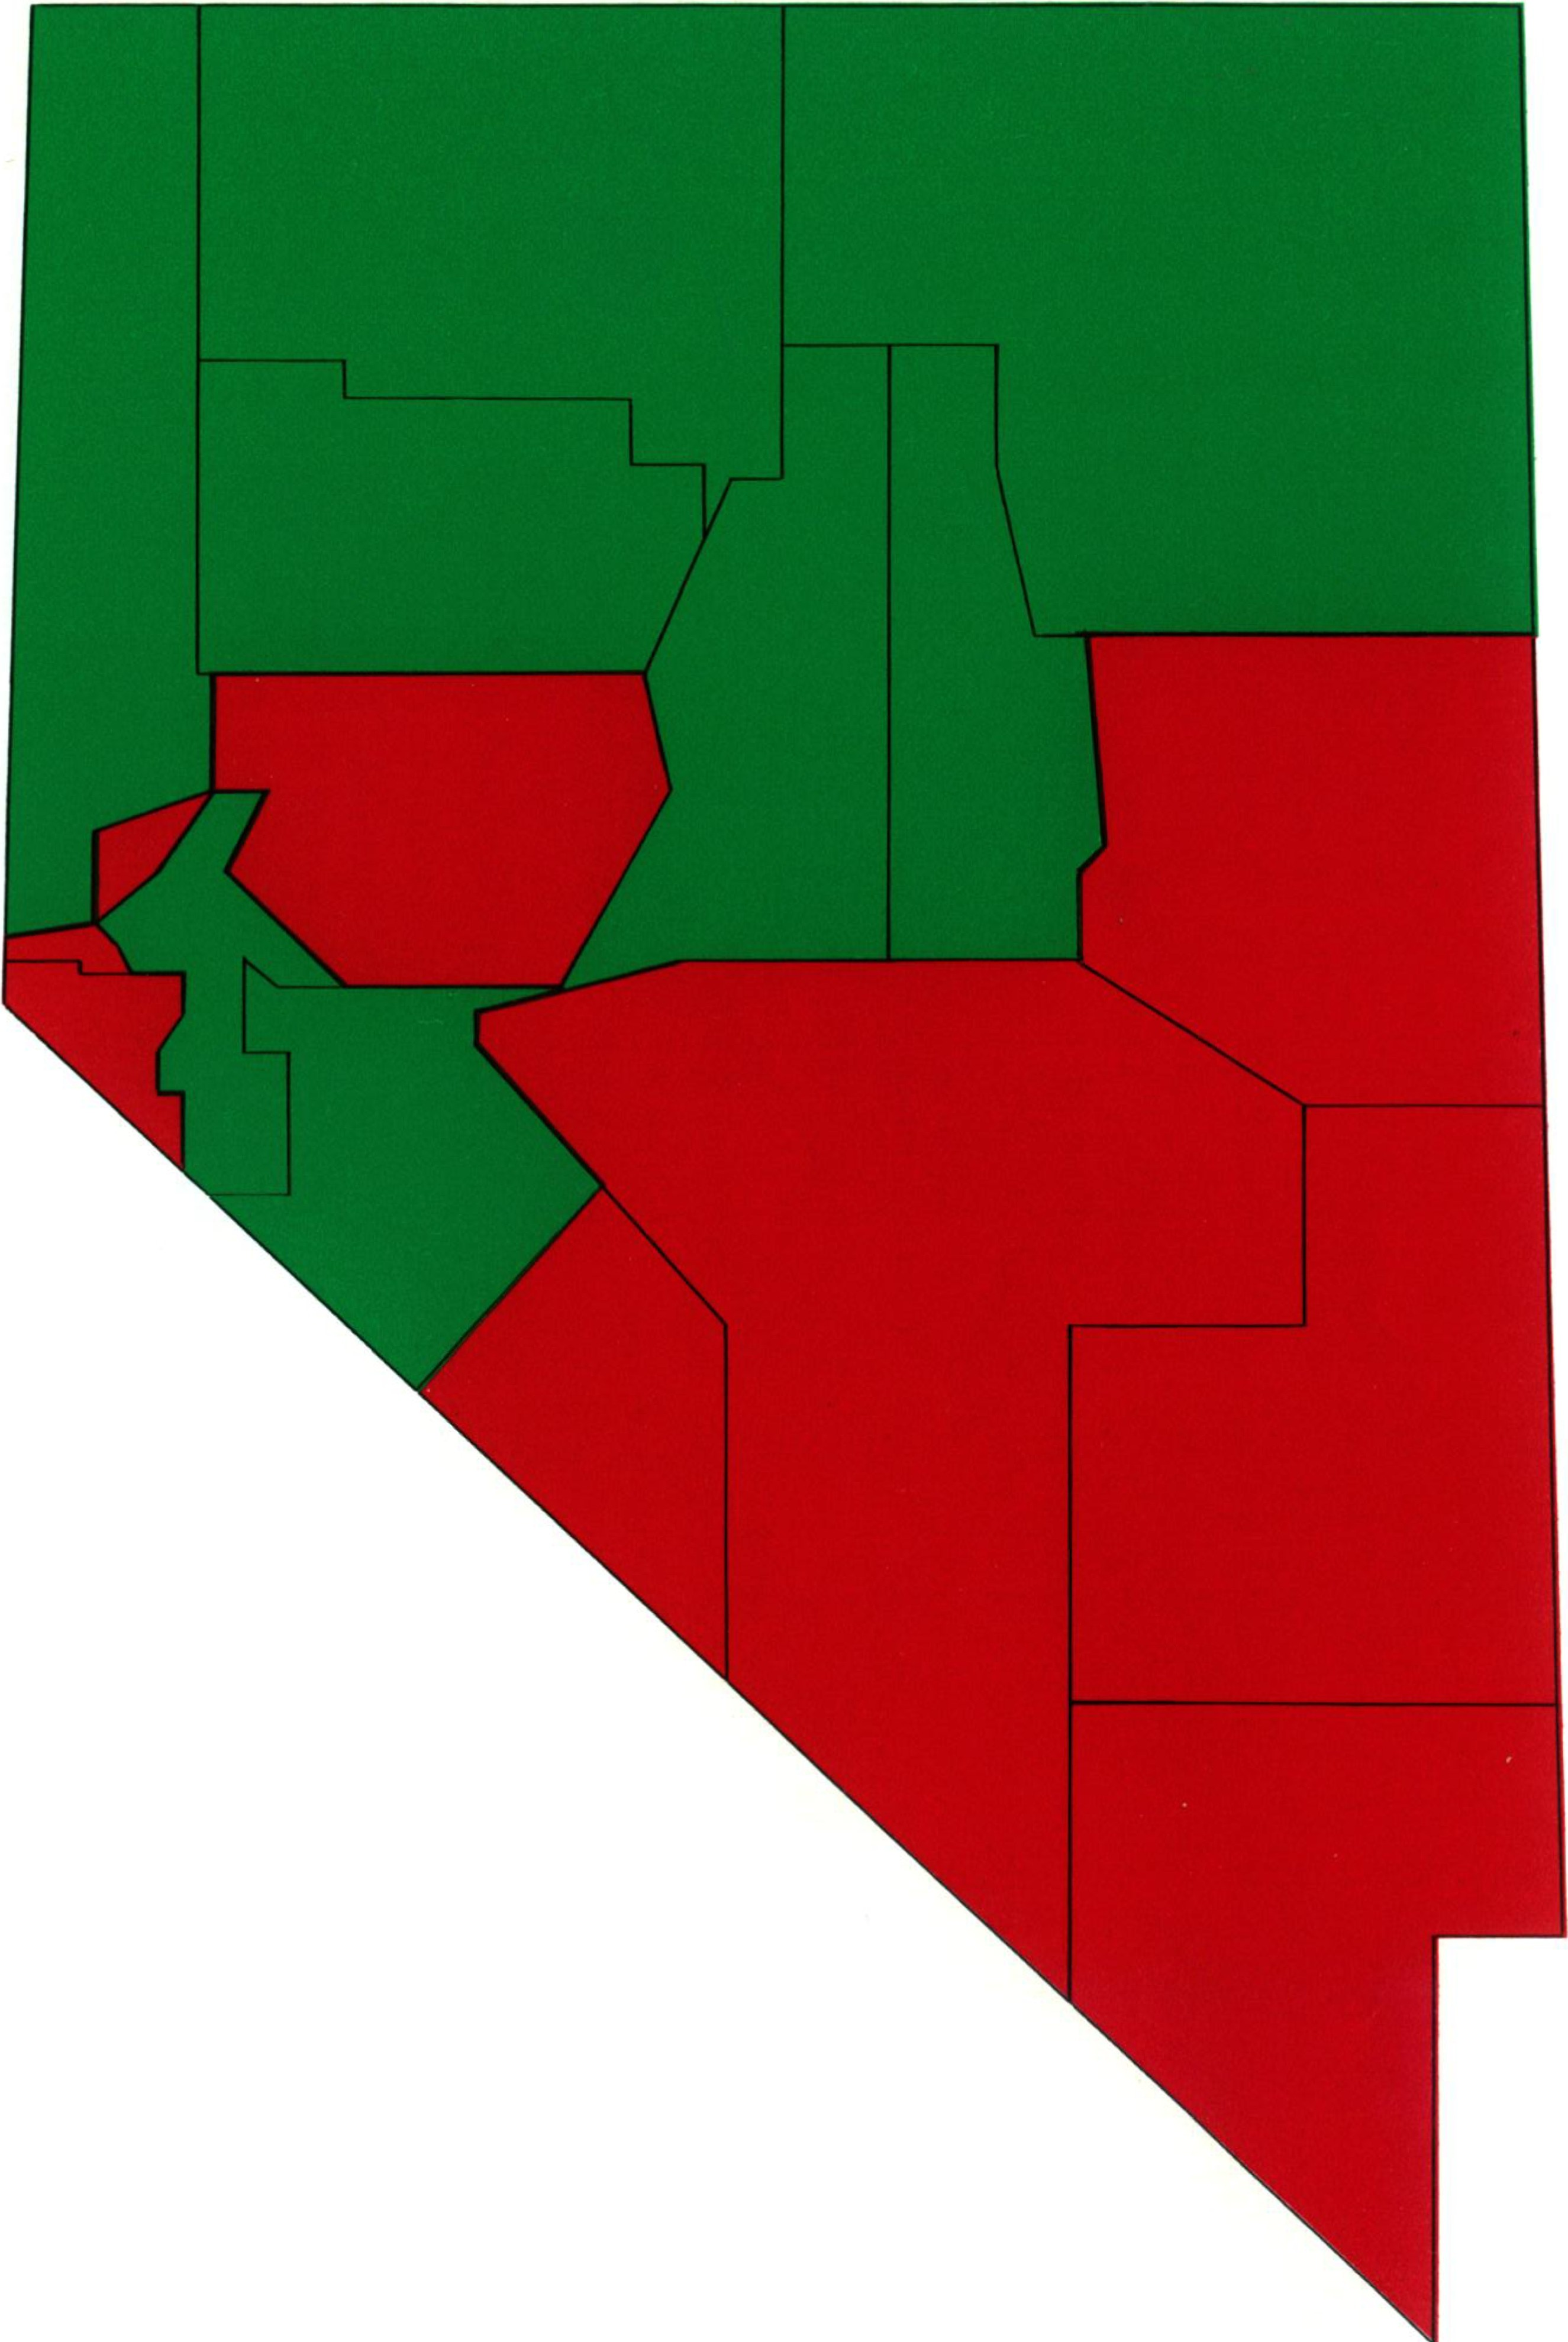
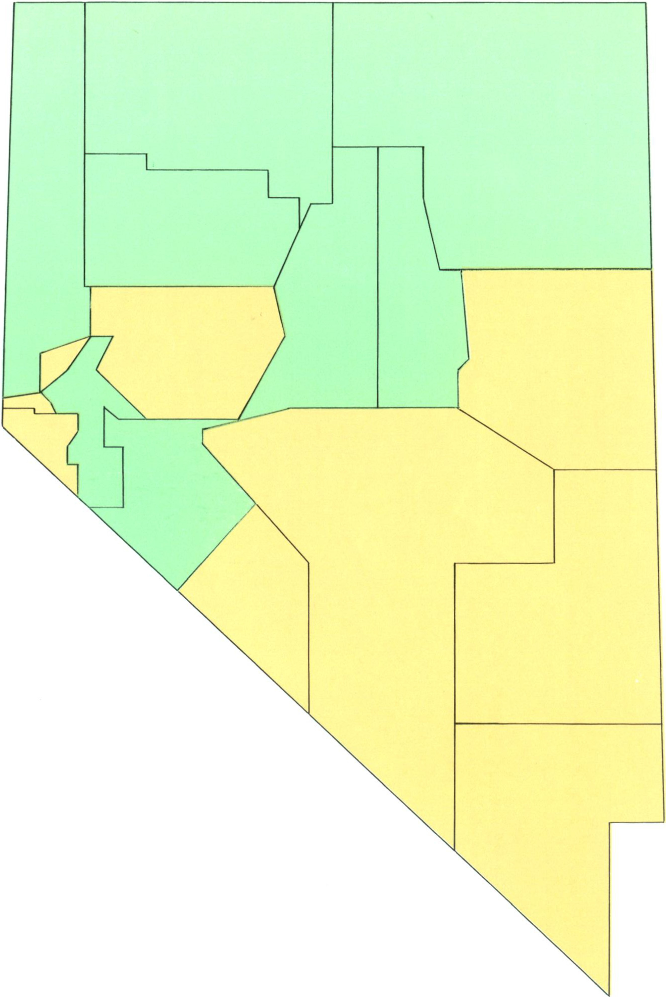
which area is larger, red or green?
Figure 1. Stimulus From the High-Saturation Group
Figure 2. Stimulus From the Low-Saturation Group

Slide 45
Takeaway
We have a strong propensity to assume our judgments of color are absolute, when in fact they are extremely relativistic.
Do your best to not place data in difficult contexts. Use color sparingly.

Slide 46
guidelines
color is a relative medium—if encoding ordinal data with color, place marks on solid, neutral background
because of contrast effects, it is difficult to perceive absolute luminance of noncontiguous regions
for text, ideally use 10:1 ratio, 3:1 minimum

Slide 47
Guidelines
in small regions use bright, highly saturated colors
for points and lines use just two saturation levels
use low saturation pastel colors for large regions and backgrounds

Slide 48



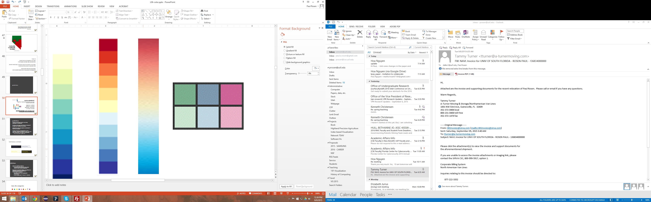
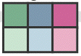
what is a colormap?
specifies a mapping between color and values
also called a transfer function
categorical vs ordered
sequential vs diverging
segmented vs continuous
univariate vs bivariate
expressiveness: match colormap to attribute type characteristics!
[0,8]
56

Slide 49
guidelines
categorical colors are easier to remember if they are nameable
ordered colormaps should vary along saturation or luminance
bivariate colormaps are difficult to interpret if at least one variable is not binary

Slide 50
hues for categories

Slide 51
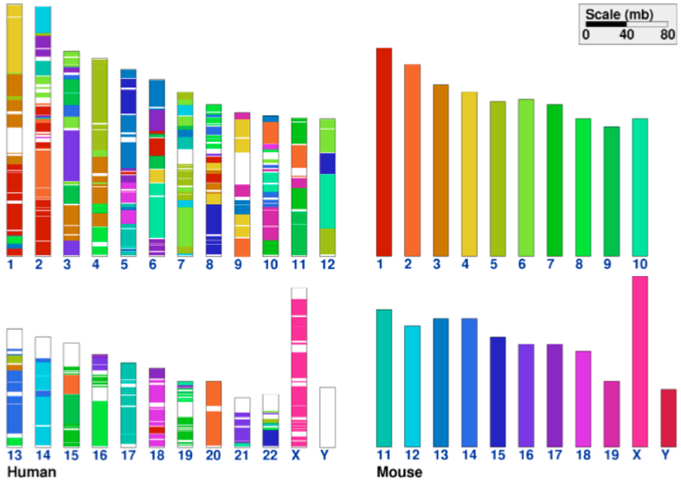
distinguishability
only good at distinguishing 6-12 simultaneous colors

Slide 52
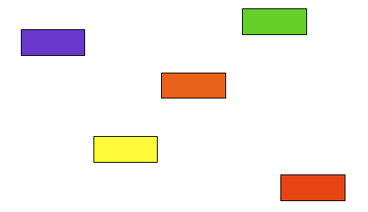
order these colors…

Slide 53
order these colors…

Slide 54
order these colors…

Slide 55
guidelines
luminance and saturation are most effective for ordinal data because they have an inherent ordering
hue is great for categorical data because there is no inherent ordering
but limit number of hues to 6-12 for distinguishability
number of hues and distribution on the colormap should be related to which and how many structures in the data to emphasize

Slide 56

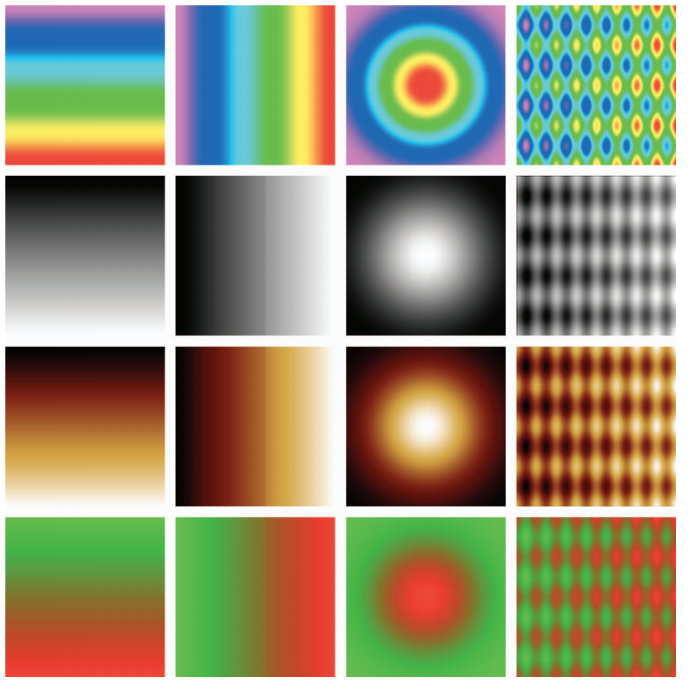

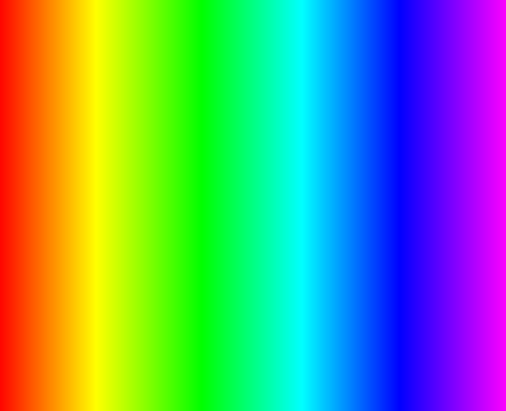
rainbow colormaps: challenges
Contrast
Frequency
Contrast
Frequency
Borland 2007

Slide 57
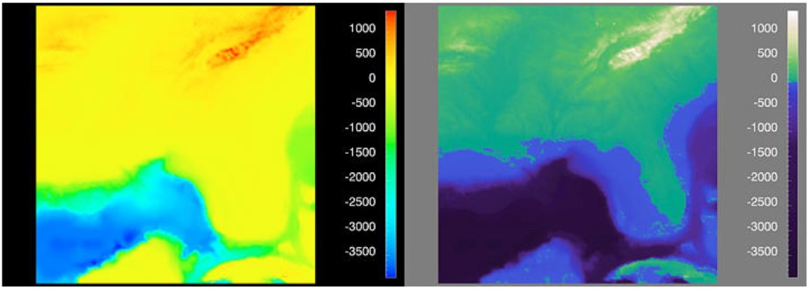
rainbow colormaps: challenges
zero crossing not explicit

Slide 58
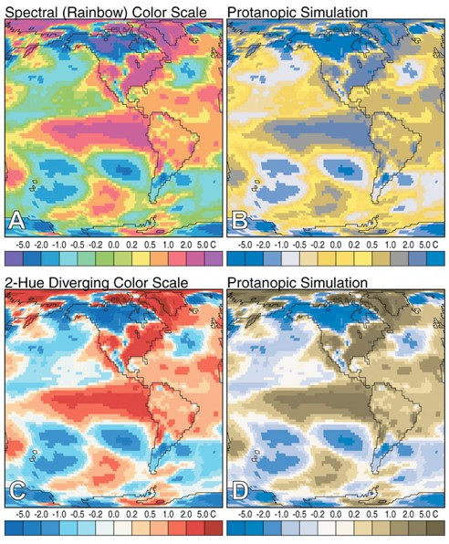
rainbow colormaps: challenges

Slide 59
Color section Guidelines

Slide 60
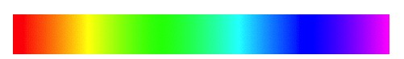


Rainbow guidelines
poor
better

Slide 61










Complementary—high contrast creates a vibrant look
Analogous—often found in nature and are harmonious and pleasing to the eye
Triad—vibrant, even if you use pale or unsaturated versions of your hues
Split-complementary—same strong contrast as the complementary but less tension
Rectangle—rich color scheme offers plenty of possibilities for variation
Color Harmonies
http://www.tigercolor.com/color-lab/color-theory/color-harmonies.htm

Slide 62




LOOK TO NATURE

Slide 63

SIMPLICITY
choose one color to be used in larger amounts
be selective about the base color
use other colors to add interest

Slide 64
AVOIDANCE OF COLOR
use neutrals (work with any scheme)
black, white, grey
use diagrammatic marks (may be better encoding channels)
size, shape, texture, length, width, orientation, curvature and intensity

Slide 65
Get it right in black and white.
Maureen Stone

Slide 66
tools for color

Slide 67

Colorbrewer2.org

Slide 68

MUDCU.BE/sphere

Slide 69



Kuler.adobe.com

Slide 70



GNER
ColorSchemeDesigner.com

Slide 71

Colormine.org/color-converter

Slide 72

Vischeck.com

Slide 73
Recommended Reading
Visualization Analysis & Design: Chapter 10 (pp. 218-241)

